Slide 1
Welcome to the Era of Big Psychology
Rick Klein
Université Grenoble Alpes

Slide 2
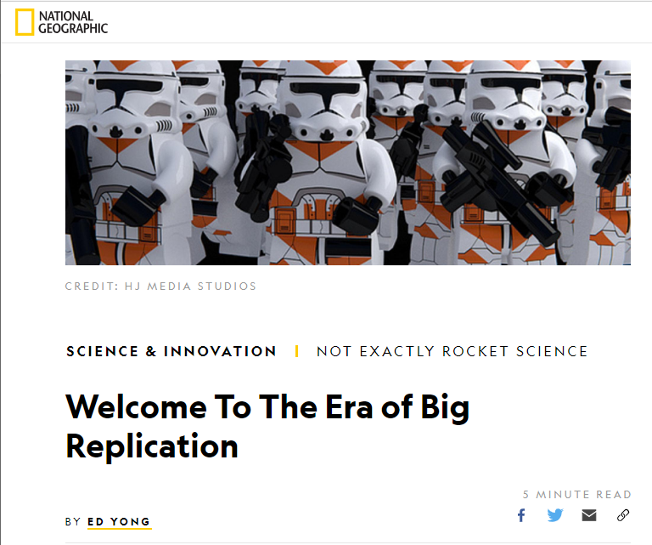

Slide 3
Overview
Quick replication catch-up
Emphasize a few large-scale projects
Discuss solutions, machine learning, and exciting new possibilities

Slide 4
Replication Crisis
Theoretical concerns

Slide 5
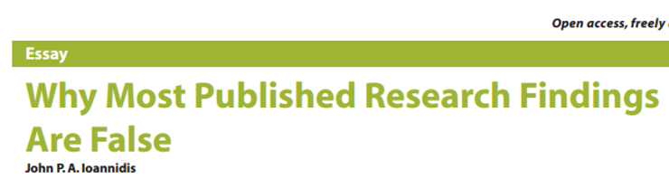
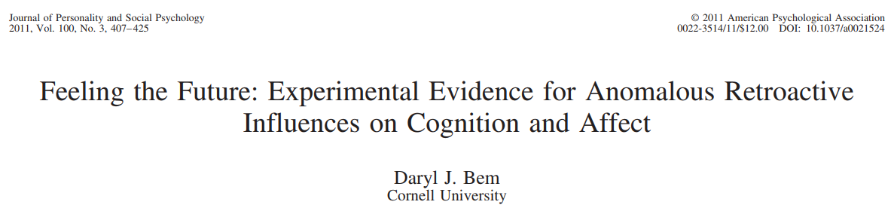
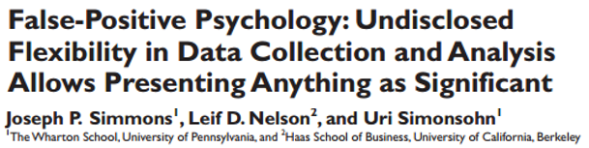
Replication Crisis
Theoretical concerns

Slide 6
Replication Crisis
Evidence of problems

Slide 7
Replication Crisis
Evidence of problems
Reproducibility Project: Psychology (OSC, 2015)
~40/100 replicated
Social Sciences Replication Project (Camerer et al., 2018)
13/21 replicated
Multiple large-scale Registered Reports

Slide 8
Just Social Psychology?

Slide 9
Just Social Psychology?
Probably not.

Slide 10
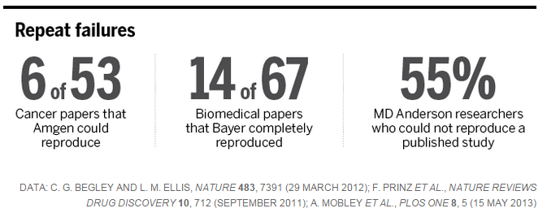
Just Social Psychology?
Probably not. Medicine:

Slide 11
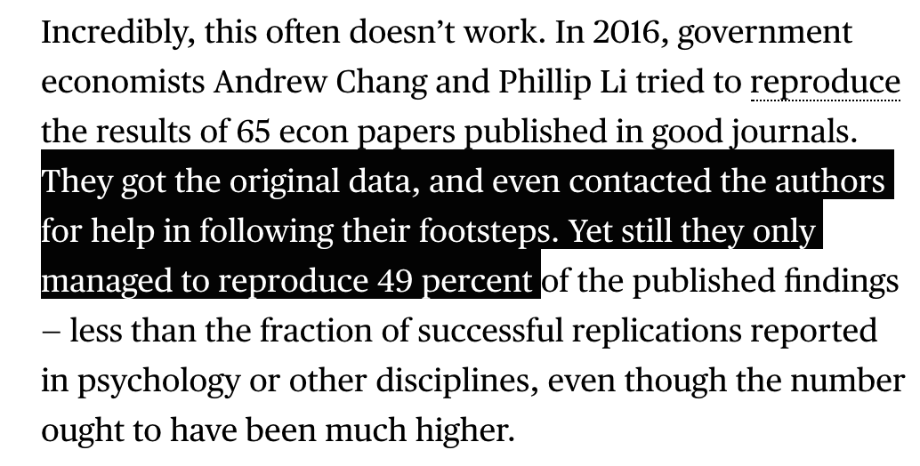
Just Social Psychology?
Probably not. Economics:

Slide 12
Just Social Psychology?
Probably not.
Why?
Problems inherent to how we implement science (e.g., publication, significance testing, career advancement, human biases)

Slide 13
Just Social Psychology?
Probably not.
Why?
Problems inherent to how we implement science (e.g., publication, significance testing, career advancement, human biases)
Differs by field
Solutions depend on cause; causes likely differ in extent

Slide 14
So, what’s exciting about this?

Slide 15
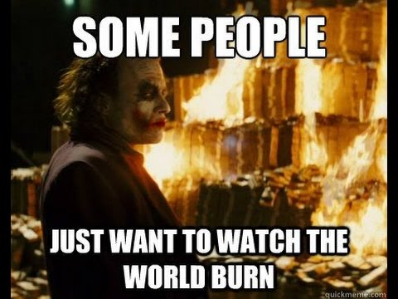
So, what’s exciting about this?

Slide 16
So, what’s exciting about this?

Slide 17
So, what’s exciting about this?
Rethinking fundamental aspects of scientific process
Lots of progress despite replication woes
Lots of ways to accelerate pace of discovery
May explain seemingly low applied/policy impact
Huge thirst for methodological innovation
To understand and improve replication rates, ability to predict

Slide 18
Many Labs Replication Projects
Large international collaboration of labs
Replicate the same findings
Explore different aspects of replication

Slide 19
Many Labs 2
How much variation should we expect when labs around the world replicate the same effect?
What counts as “valid” replication?
Is a replication of US work in Italy valid? What about Japan? Or Nigeria?

Slide 20
Many Labs 2
Many potential causes for replication failures
False positives
Incompetent replicators
Imprecise theory (unknown moderators)
Contextual differences
Etc.

Slide 21
Many Labs 2
Many potential causes for replication failures
False positives
Incompetent replicators
Imprecise theory (unknown moderators)
Contextual differences
Etc.

Slide 22
Many Labs 2
Replicated 28 high-impact studies
Experts reviewed each in advance (Registered Report)
Each administered across 60+ labs

Slide 23
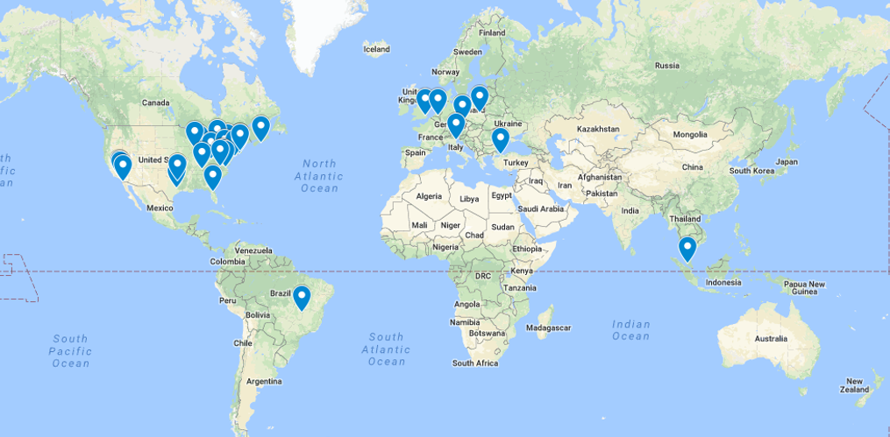
Many Labs 1 Map (2014)

Slide 24
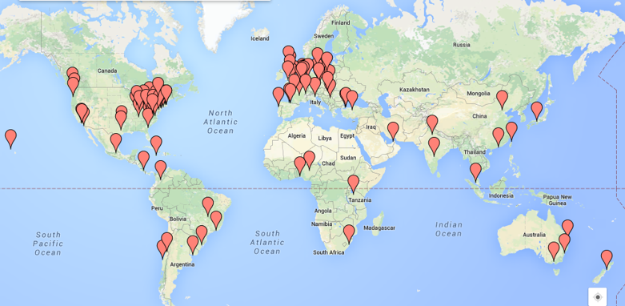
Many Labs 2 Map (2018)

Slide 25
Many Labs 2 Map (2018)
125 samples
36 countries
16 languages
15,305 participants

Slide 26
ML2 Results

Slide 27
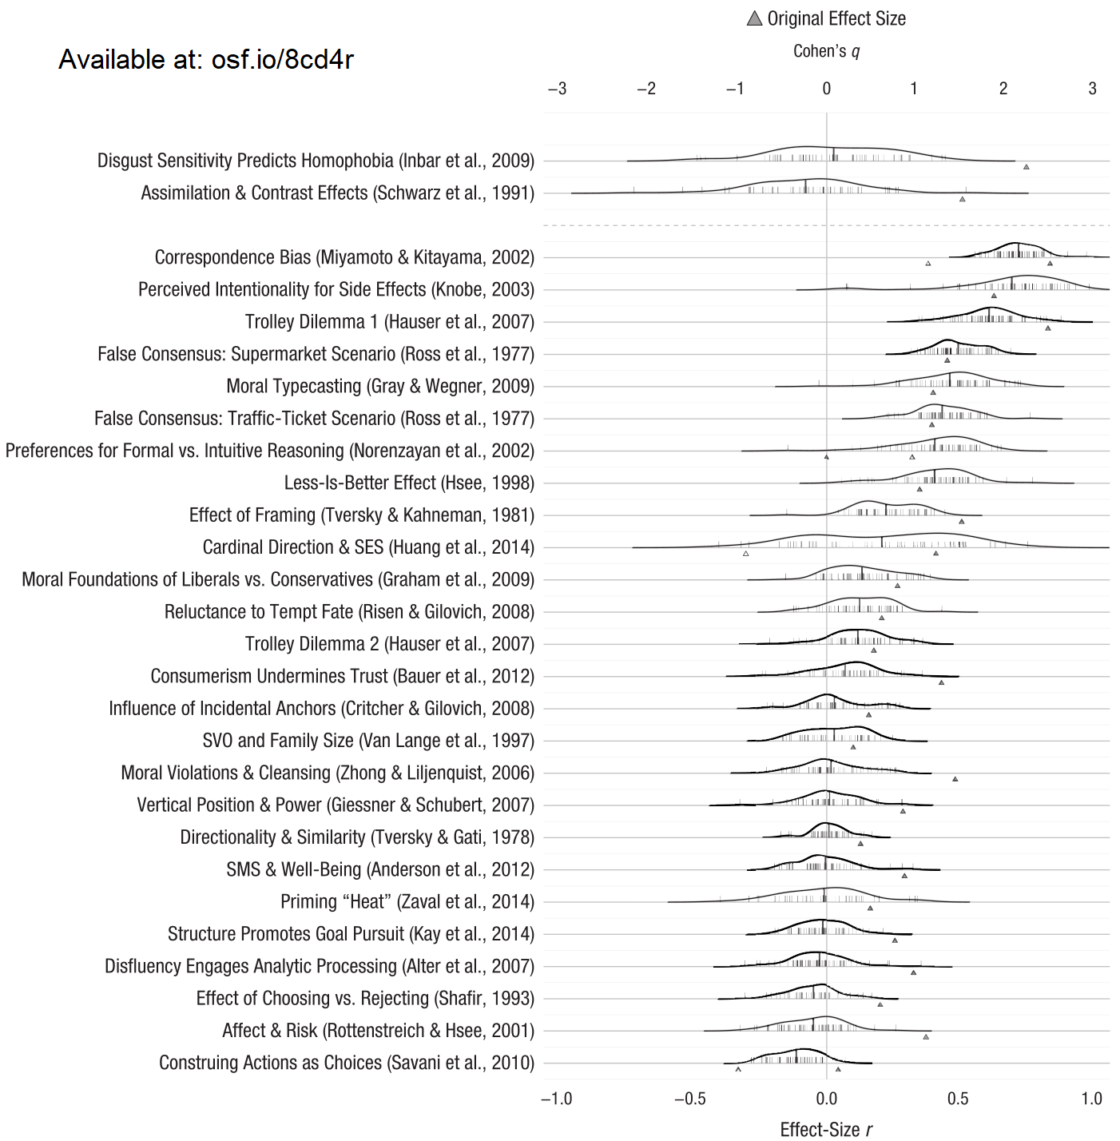
ML2 Results

Slide 28
ML2 Results
14/28 successful

Slide 29
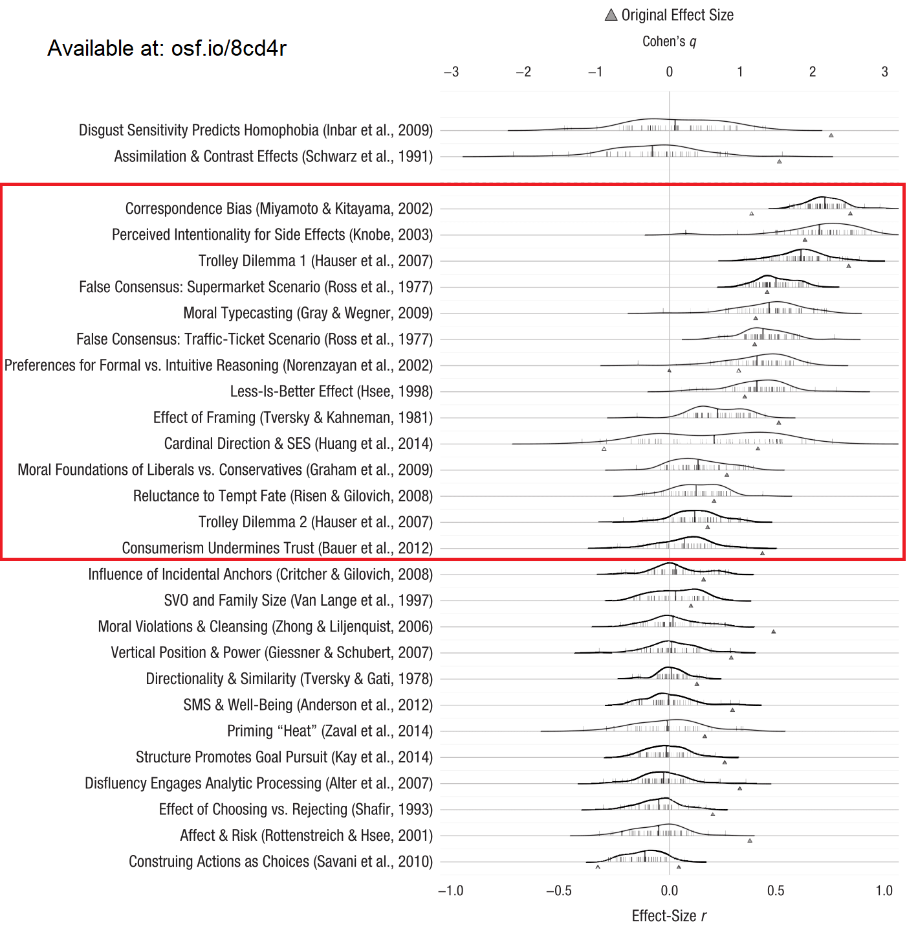
ML2 Results
14/28 successful

Slide 30
ML2 Results
14/28 successful
Smaller effect sizes
d = 0.60 vs d = 0.15

Slide 31
ML2 Results
14/28 successful
Smaller effect sizes
d = 0.60 vs d = 0.15
(boring)

Slide 32
ML2 Heterogeneity
11/28 Q < .001
Sig. variability

Slide 33
ML2 Heterogeneity
11/28 Q < .001
Sig. variability
HOWEVER:
26/28 Tau ≤ 0.1
Often 0
Very little heterogeneity

Slide 34
ML2 Heterogeneity
11/28 Q < .001
Sig. variability
HOWEVER:
26/28 Tau ≤ 0.1
Often 0
Very little heterogeneity
Wait… What?

Slide 35
Mostly seeing
sampling error:
N = 80 per site

Slide 36
Mostly seeing
sampling error:
N = 80 per site
Replication success
did not depend on
sample
Good news!

Slide 37
Many Labs 2 Follow-ups
In 12 cases, original authors predicted necessary constraints:
Specific populations/subgroups, pencil/paper administration, orientation of screen, etc.
11/12 cases showed little-to-no evidence for predicted moderator
1 strongly supported
Suggests intuitions are often incorrect

Slide 38
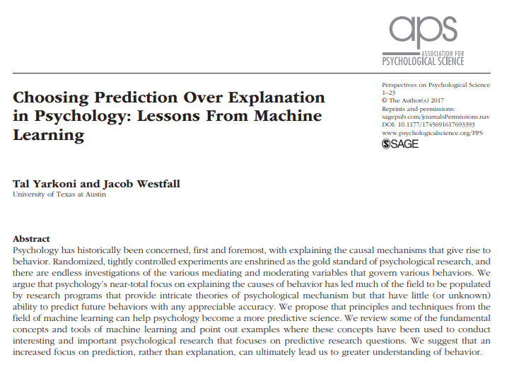

Slide 39
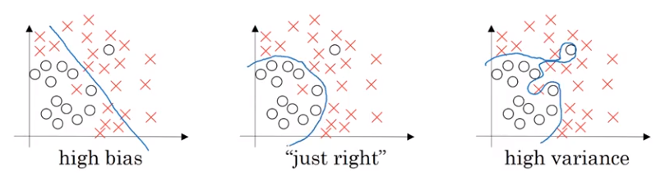
Overfitting
Andrew Ng
Deeplearning.ai

Slide 40
Many Labs 2 Follow-ups
Key feature in machine learning: Cross-validation

Slide 41
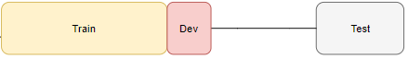
Many Labs 2 Follow-ups
Key feature in machine learning: Cross-validation

Slide 42
Many Labs 2 Follow-ups
Key feature in machine learning: Cross-validation
ML2 commentaries: All original authors invited to write one

Slide 43
Many Labs 2 Follow-ups
Key feature in machine learning: Cross-validation
ML2 commentaries: All original authors invited to write one
Can always find moderators after the fact: are they reliable?

Slide 44
Many Labs 2 Follow-ups
1/3 exploratory split provided freely
2/3 confirmatory split kept confidential
Analyzed data, wrote commentary, pre-registered.
Analysis script re-run on 2/3 split
Reported no matter what
Not quite holdout validation
Only 3 authors opted for this procedure, mixed results

Slide 45
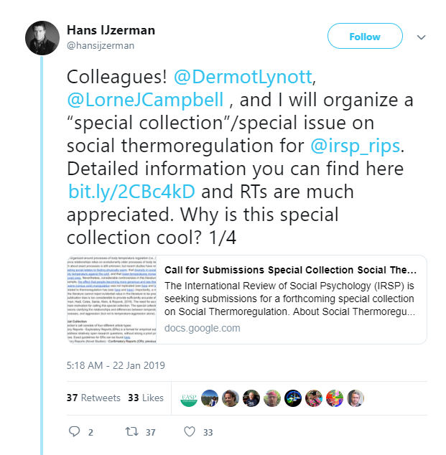
Many Labs 2 Follow-ups

Slide 46
“Many Moderators” Project?
Ongoing project
Examine all individual-level moderators, across all Many Labs projects
Demographics, Big-5, SES, Cognitive Reflection, etc. etc.
Throw into a massive model and cross-validate? Machine learning techniques instead?
Initial half-attempt to predict replication:

Slide 47
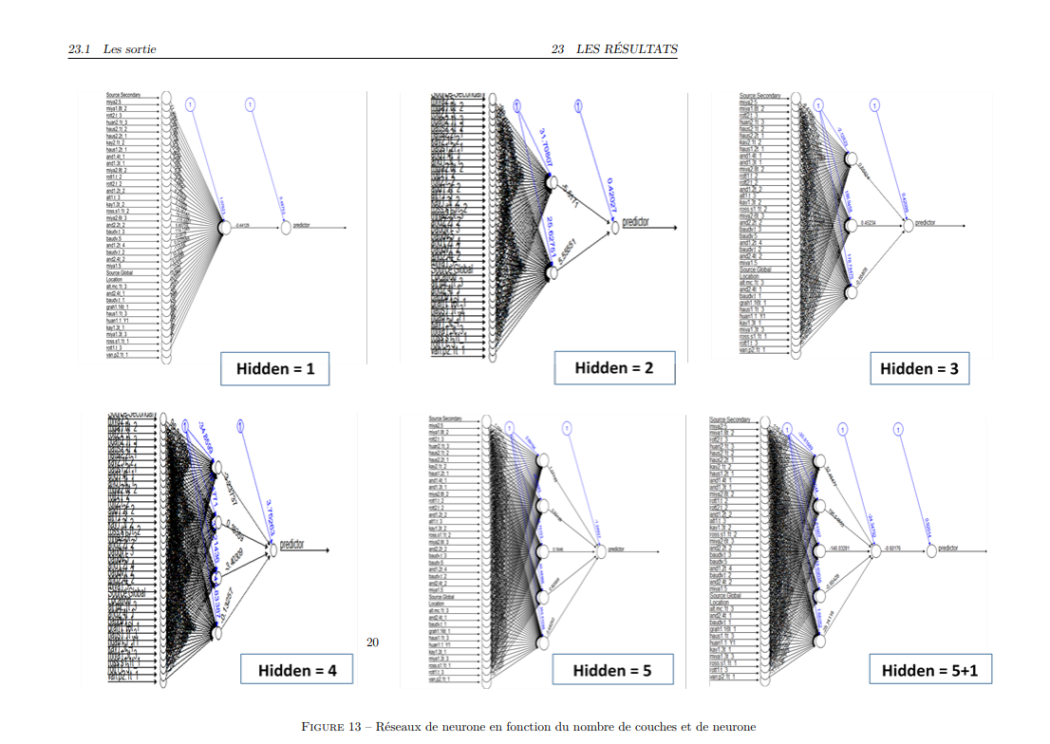
Neural Networks attempt
Credit: Armel Soubeiga

Slide 48
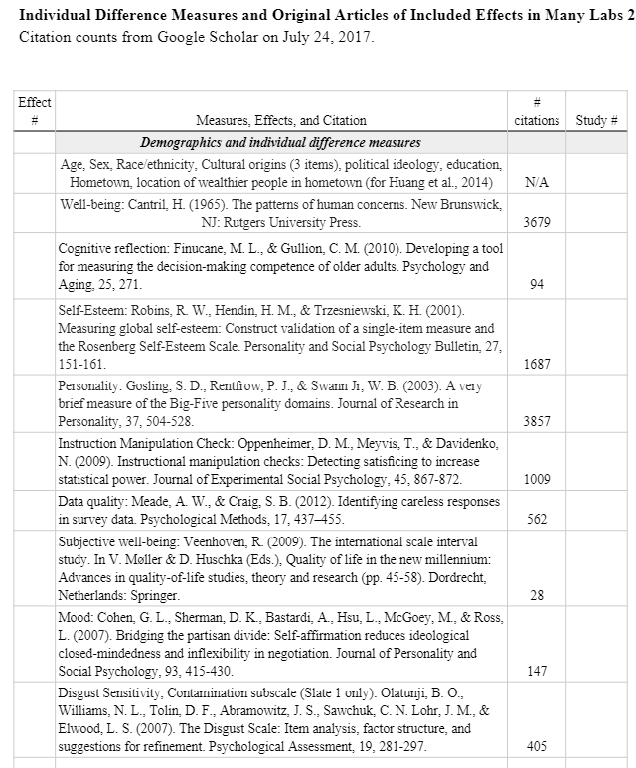
ML Data
ML2 data: https://osf.io/8cd4r/
CC0, public domain
15,305 observations
~500 usable variables

Slide 49
SCORE Project
Using machine learning to predict credibility of research

Slide 50
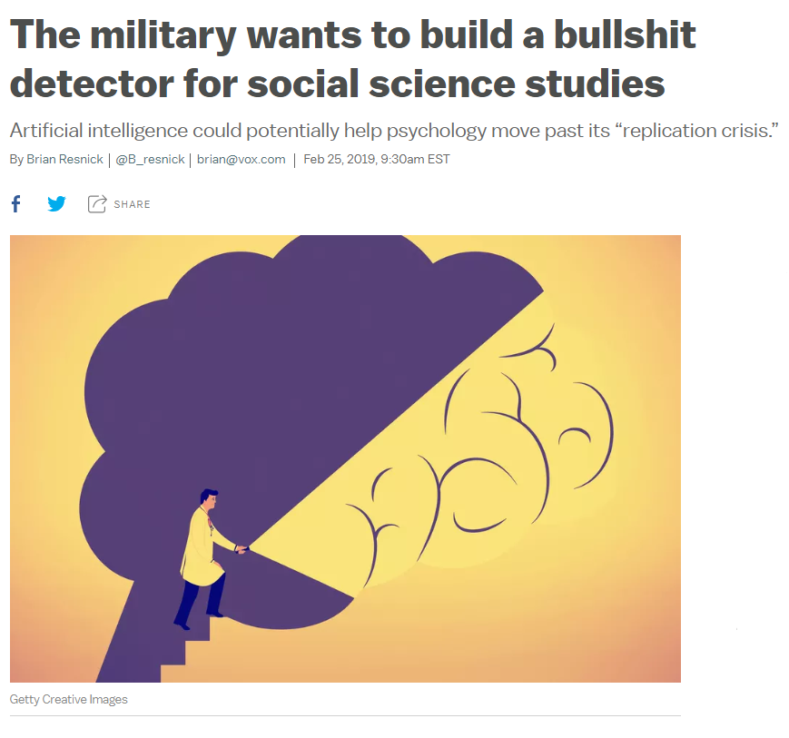

Slide 51
SCORE Project
Center for Open Science (cos.io/about/news/)
$7.6 million grant
Build database of 30,000 papers
Sample 3,000 papers to augment with human and automated data
Humans and machines try to generate credibility predictions for these 300
300 actual replications are conducted to test the credibility predictions

Slide 52
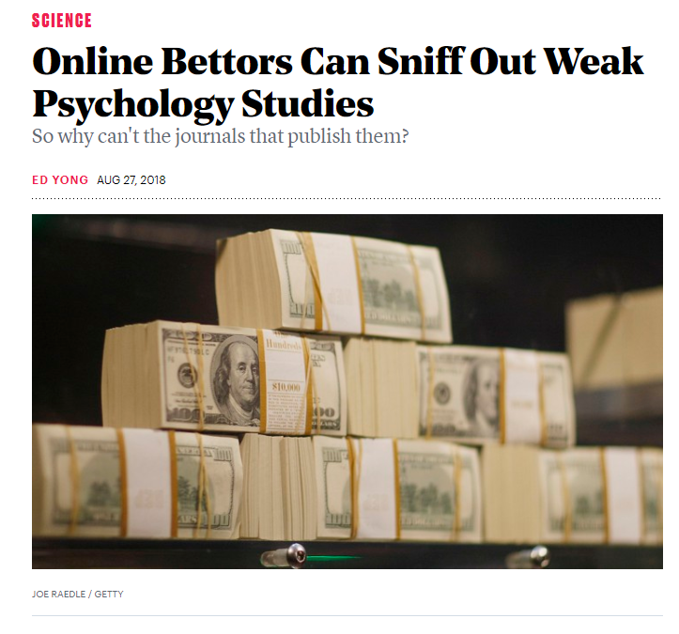

Slide 53
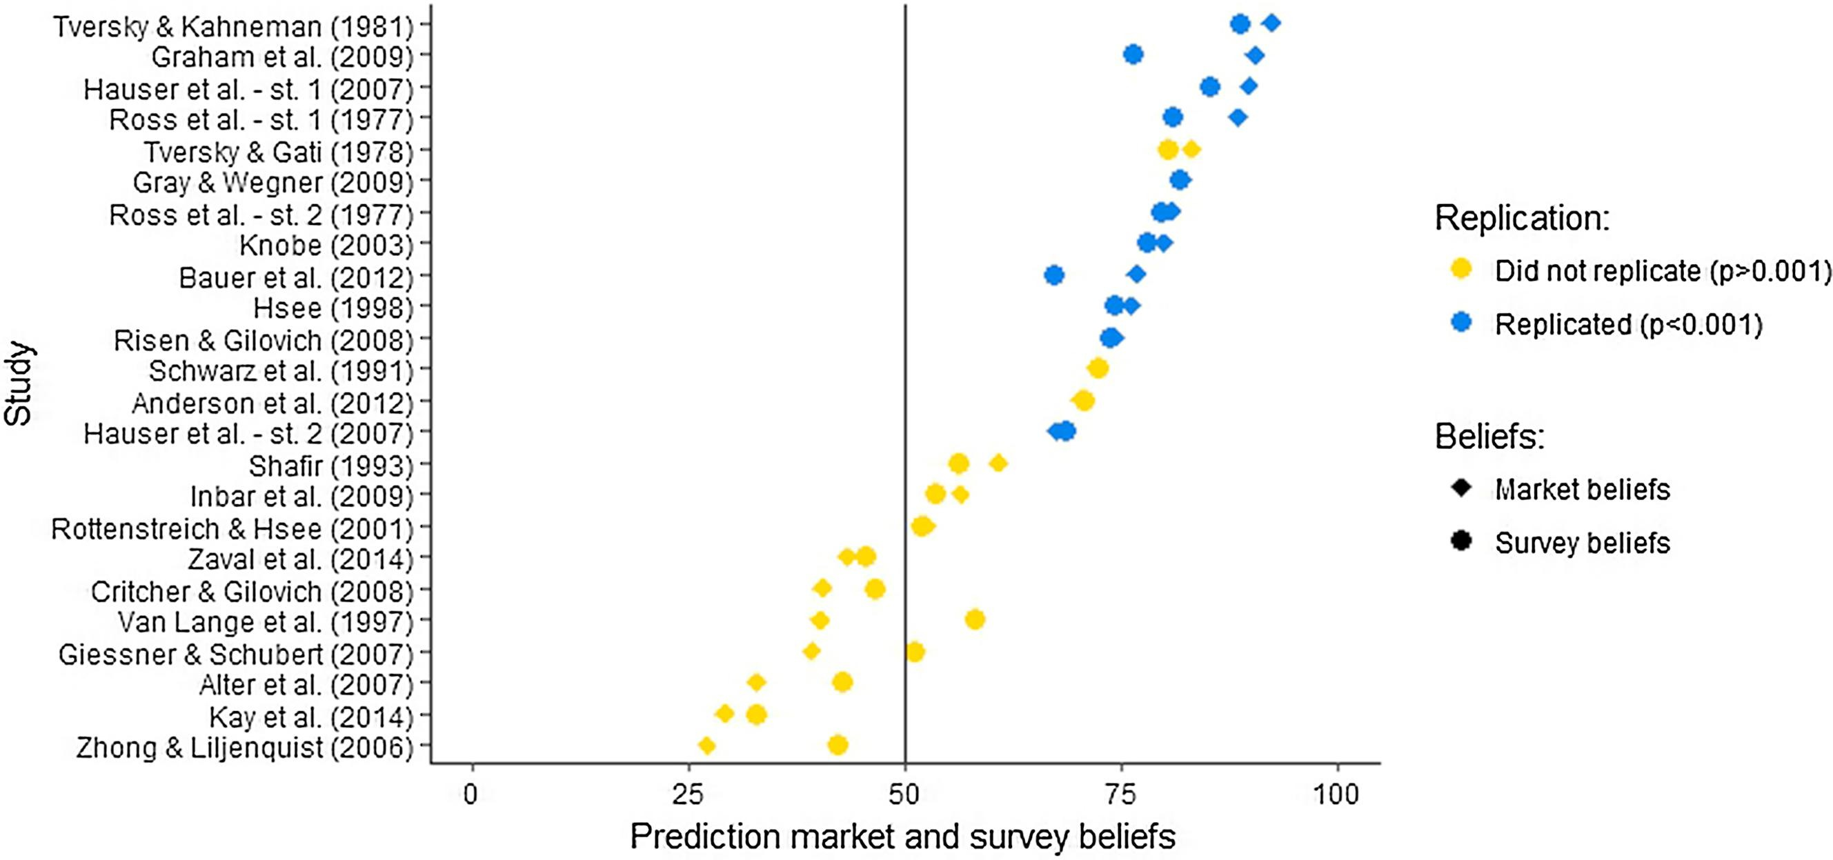

Slide 54
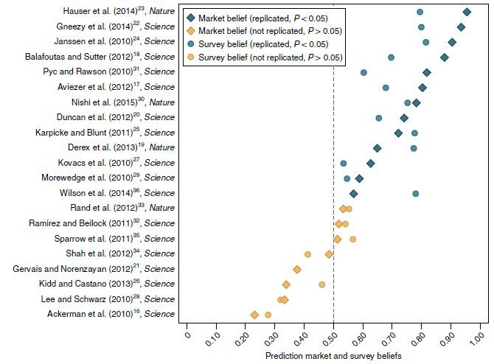

Slide 56
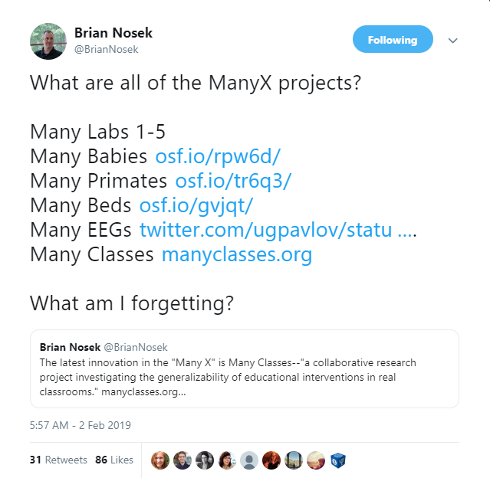
https://twitter.com/briannosek/status/1091697136037699589

Slide 57
Many Numbers: osf.io/e4xb7/
Many Dogs: @scienceofdog
Many Smiles: psyarxiv.com/cvpuw/
Many Analysts: osf.io/j5v8f/
Many VRs?
Many Scanners?
https://twitter.com/briannosek/status/1091697136037699589

Slide 58
Many Numbers: osf.io/e4xb7/
Many Dogs: @scienceofdog
Many Smiles: psyarxiv.com/cvpuw/
Many Analysts: osf.io/j5v8f/
Many VRs?
Many Scanners?
All of these will have open data!!
https://twitter.com/briannosek/status/1091697136037699589

Slide 59
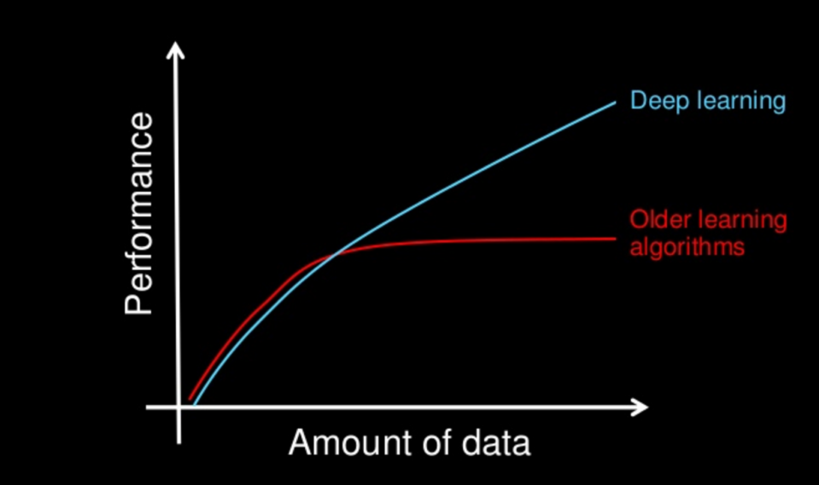

Slide 60
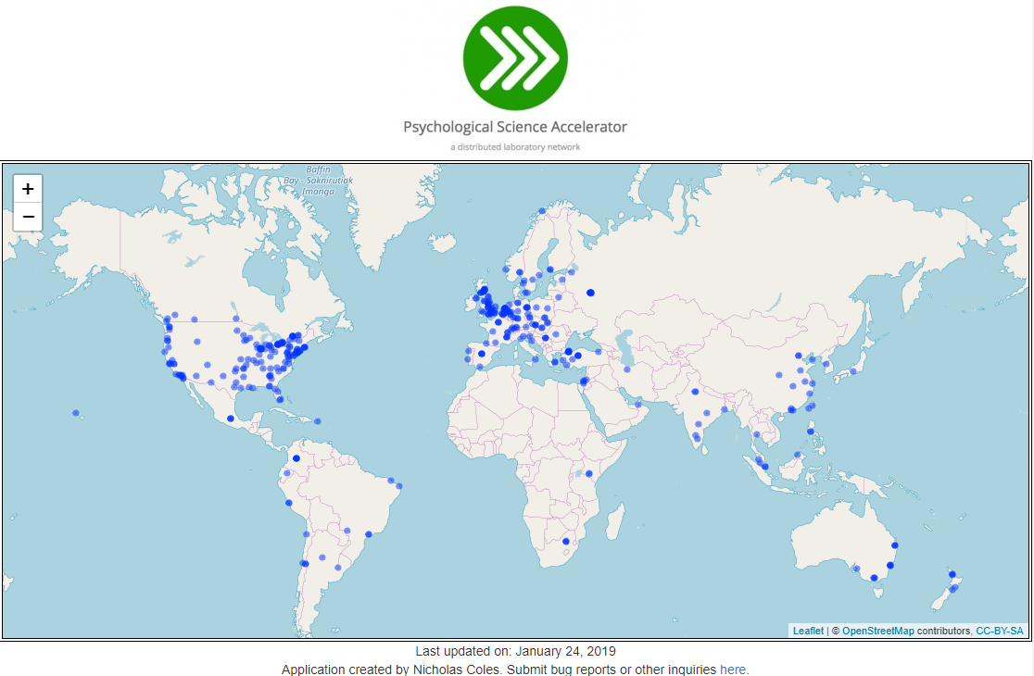
https://psysciacc.org/

Slide 61
“Common sense” solutions
Given what we know, how do we improve replicability?
Replicate (and not just in the US/Europe)
Increase statistical power
Pre-registration/Registered Reports
Open data/analysis scripts/materials
4b. Incentivize good practices
Full disclosure of results

Slide 62
Not the only possibilities
Many ways to address these problems
EX: Data flexibility/p-hacking

Slide 63
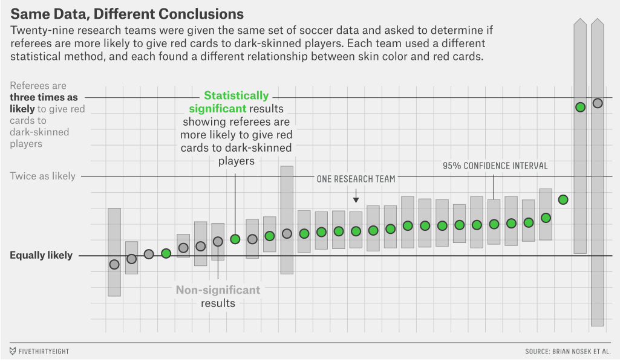
Silberzahn et al.

Slide 64
Not the only possibilities
Many ways to address these problems
EX: Data flexibility/p-hacking
Common solution: Pre-registration

Slide 65
Not the only possibilities
Many ways to address these problems
EX: Data flexibility/p-hacking
Common solution: Pre-registration
Others:
Blind data analysis: https://www.nature.com/news/blind-analysis-hide-results-to-seek-the-truth-1.18510
Specification curve/multiverse analysis

Slide 66
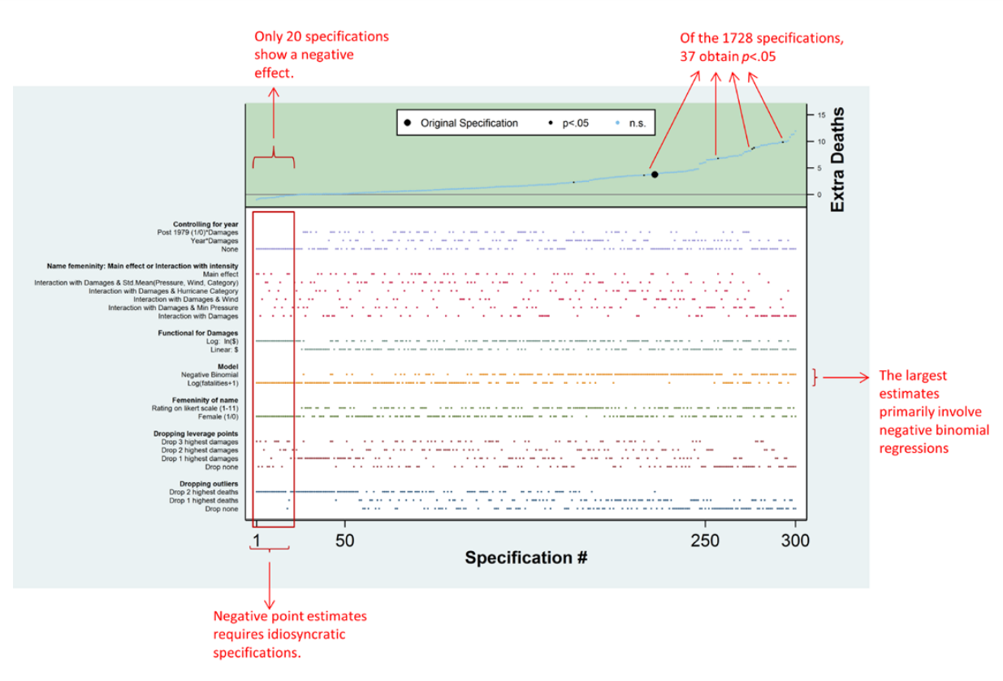
Silberzahn et al.

Slide 67
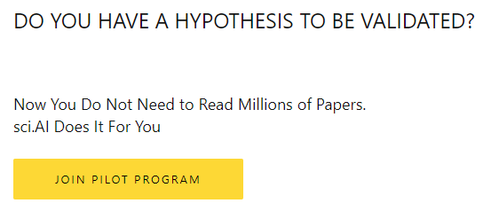
sci.ai
https://sci.ai/
Using deep learning to synthesize research

Slide 68
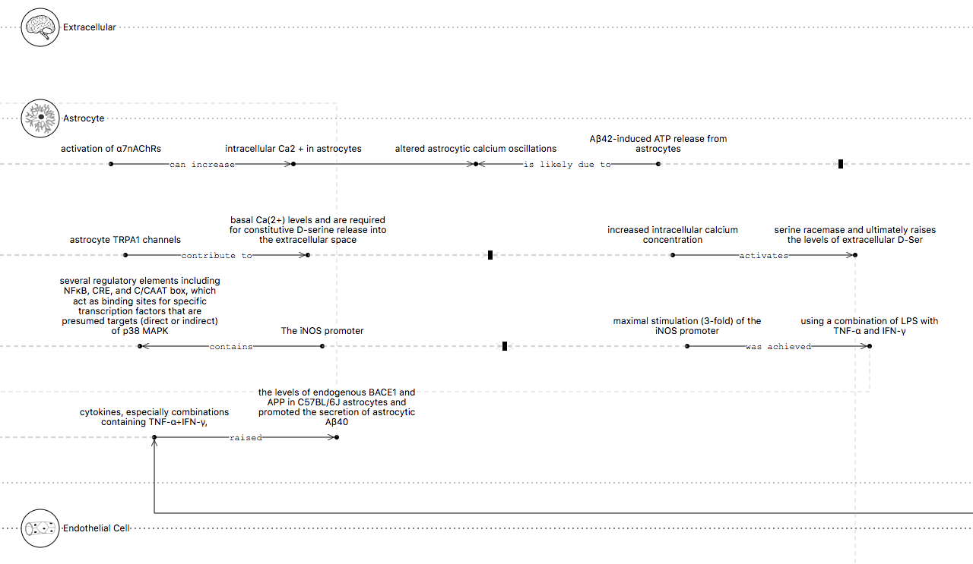
sci.ai

Slide 69
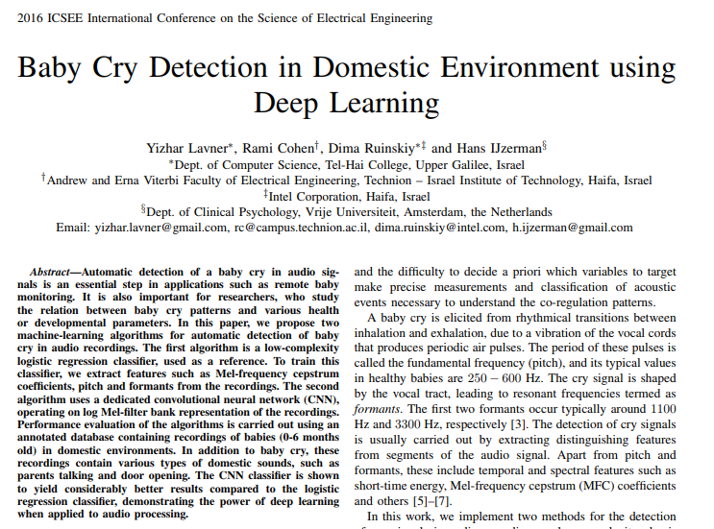
Deep Learning for Data Collection

Slide 70
Conclusion
Half of published research findings are false?

Slide 71
Conclusion
Half of published research findings are false?
Workable problem
Not the first crisis

Slide 72
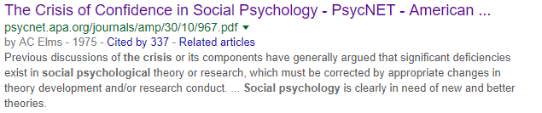
Conclusion
Half of published research findings are false?
Workable problem
Not the first crisis

Slide 73
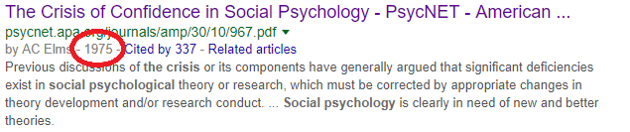
Conclusion
Half of published research findings are false?
Workable problem
Not the first crisis

Slide 74
Conclusion
Half of published research findings are false?
Workable problem
Not the first crisis
…Won’t be the last
Science is constantly evolving and innovating, which is what makes it work.
Perfect time to get involved

Slide 75


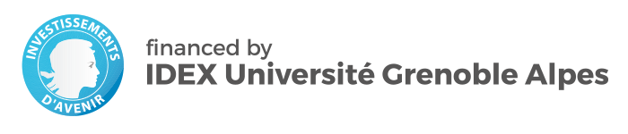
Thanks!
Thanks to many collaborators.
Slides will be posted (github.com/raklein)
Questions/comments?
https://raklein.me
@raklein3

